Slide 1

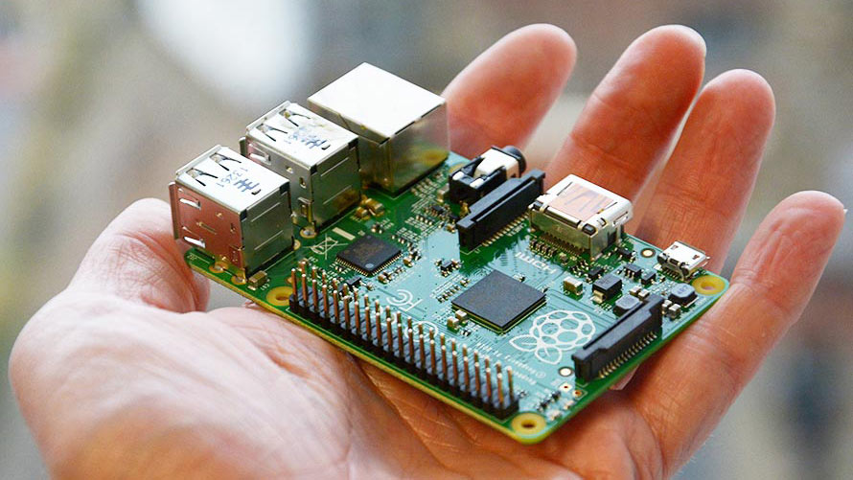
Raspberry Pi - saving the life-savers

Slide 2
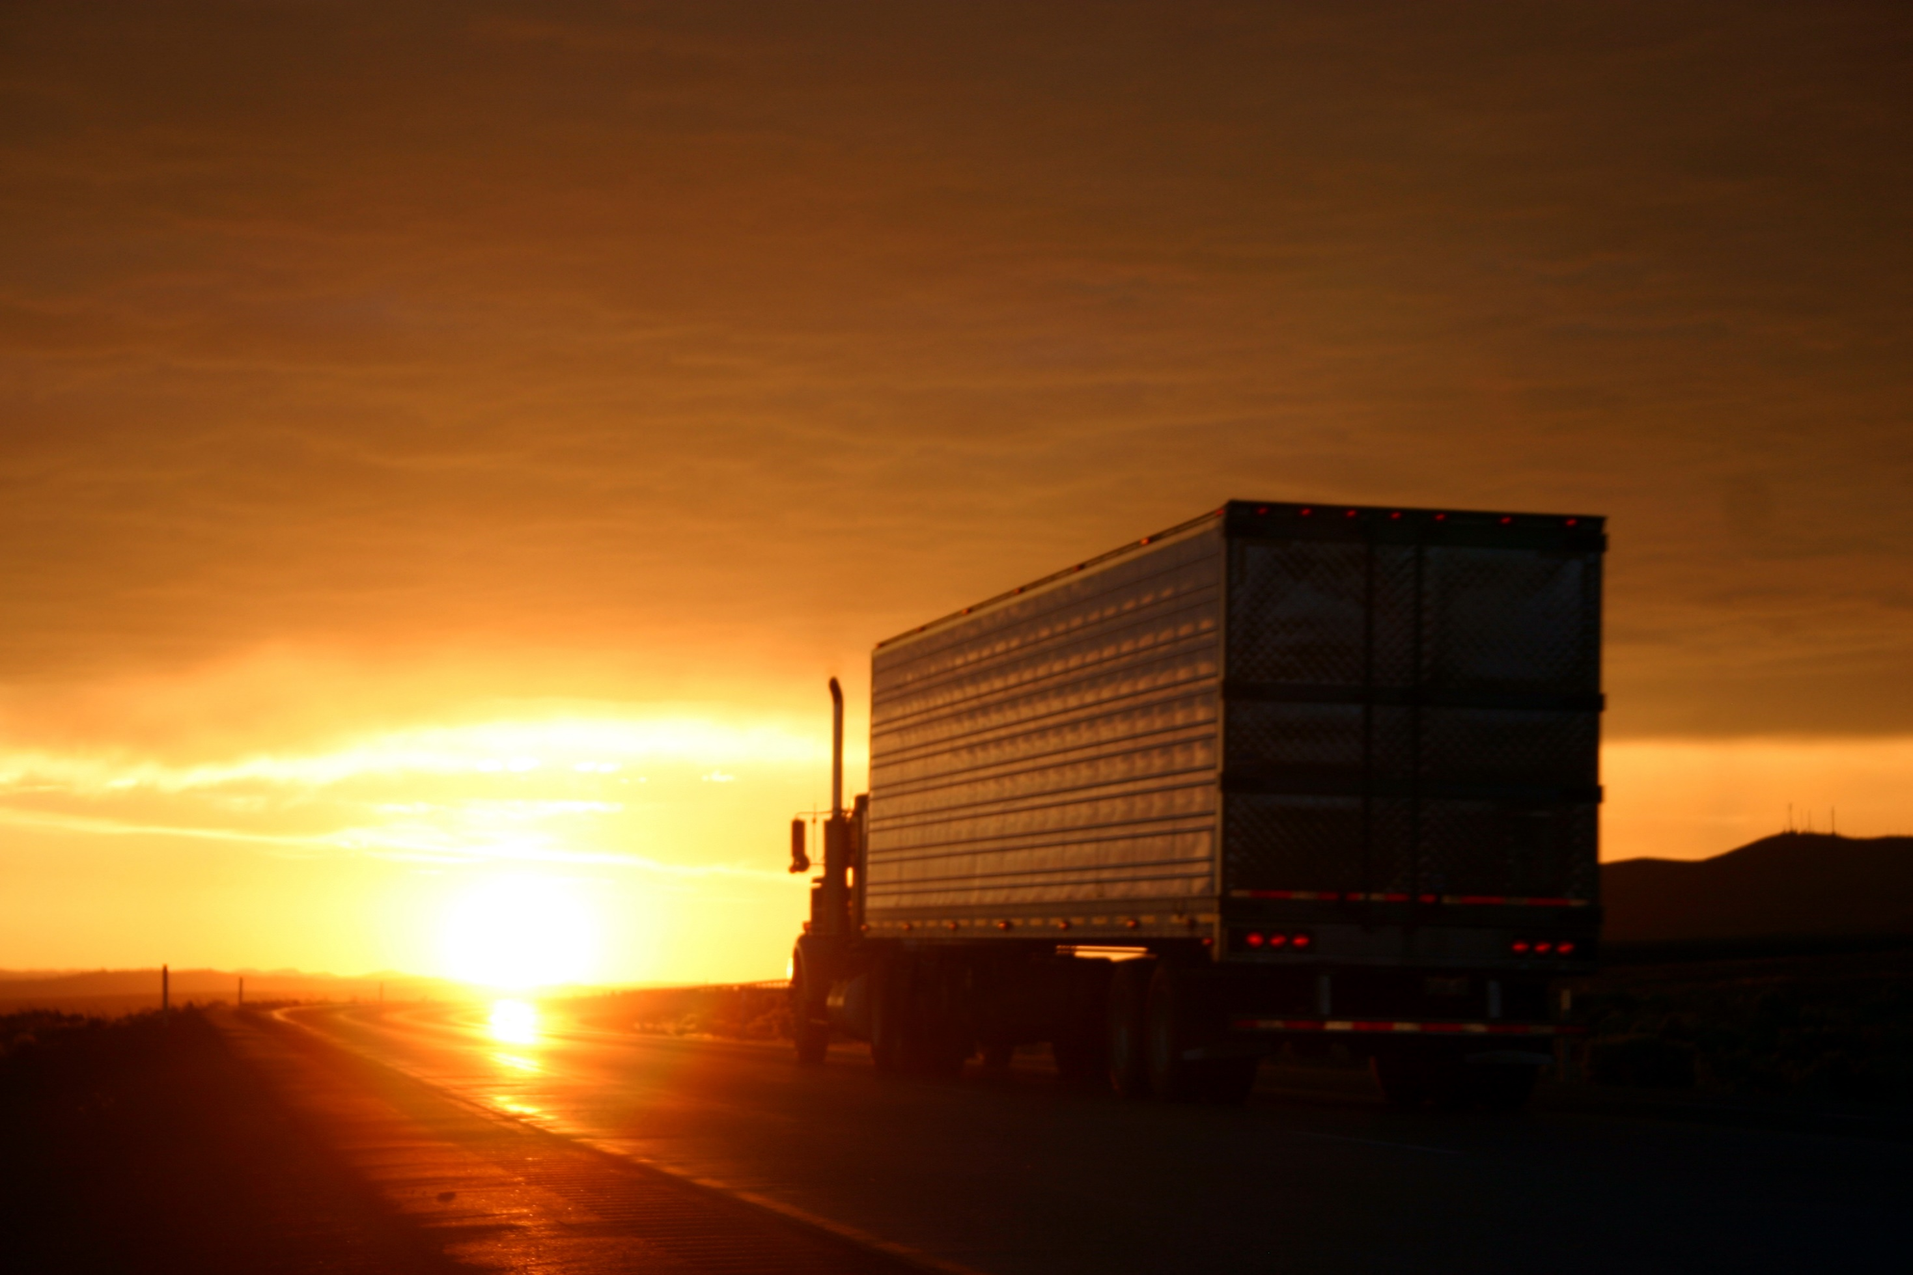

Slide 3

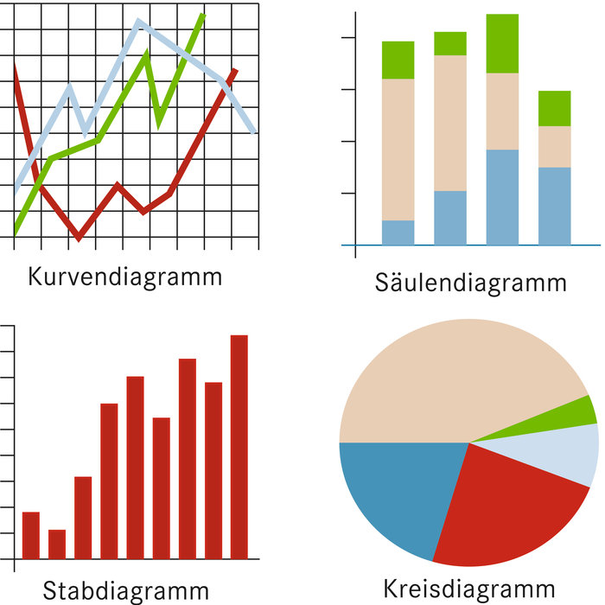



IDEA
BIG DATA
°C +

Slide 4
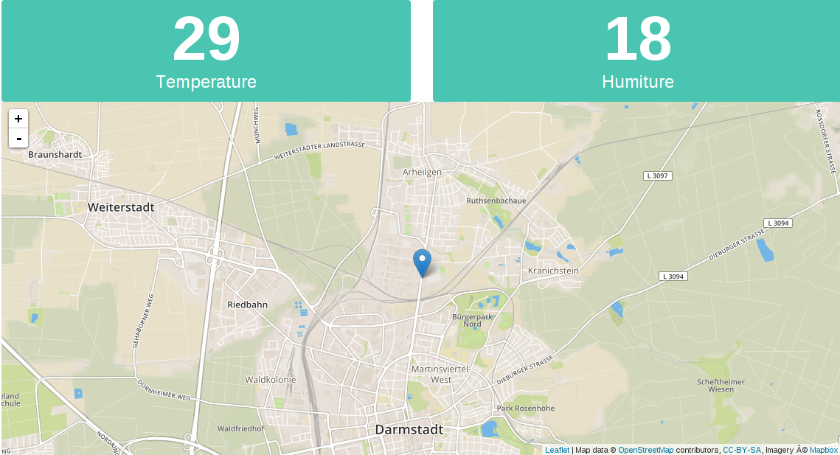

Slide 5
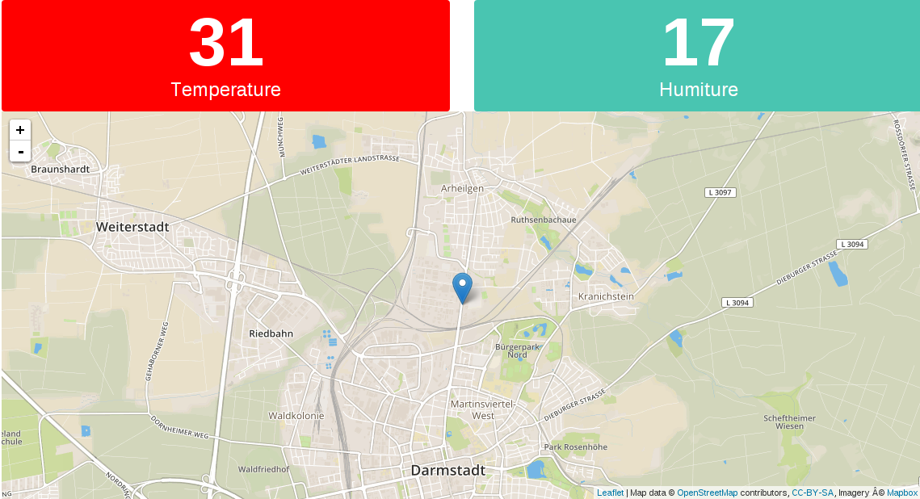

Slide 6






IMPLEMENTATION

Slide 7

FUTURE

